Slide 1




COVID-19 and gastrointestinal tract: source of infection or merely target of the inflammatory process following SARS-CoV-2 infection?
Jacopo Troisi

Slide 2

“It seems one of the great challenges in this time is knowing enough about a subject to think you're right, but not enough about the subject to know you're wrong...”
Neil deGrasse Tyson

Slide 3
SARS-CoV-2 and COVID-19
What we know
1
How SARS-CoV-2 originated and how it spread out?
2
Are there any alternative transmission routes?
3
Why does disease severity vary among individuals?

Slide 4
What we know
The city of Wuhan, the capital of Hubei Province, in China, became the center of a pneumonia epidemic of unknown cause
The disease caused by this virus was subsequently designated by the World Health Organization (WHO) Coronavirus Disease 2019 (Covid-19)
Vo’ Euganeo Population screening
WHO declared pandemic
Dec-2019
11th Feb 2020
21th Feb-7th Mar 2020
11th Mar 2020
Jan-2020
21th Feb 2020
9th Mar 2020
28 June 2021
Chinese scientists isolated a novel coronavirus from these patients, which was responsible for the acute respiratory syndrome called SARS-CoV-2 (formerly known as 2019-nCoV)
First case in Italy: Codogno
Italian Lockdown
≈180 Million infection people
≈ 4 Million death

Slide 5
SARS-CoV-2 and COVID-19
What we know
1
How SARS-CoV-2 originated and how it spread out?
2
Are there any alternative transmission routes?
3
Why does disease severity vary among individuals?

Slide 6
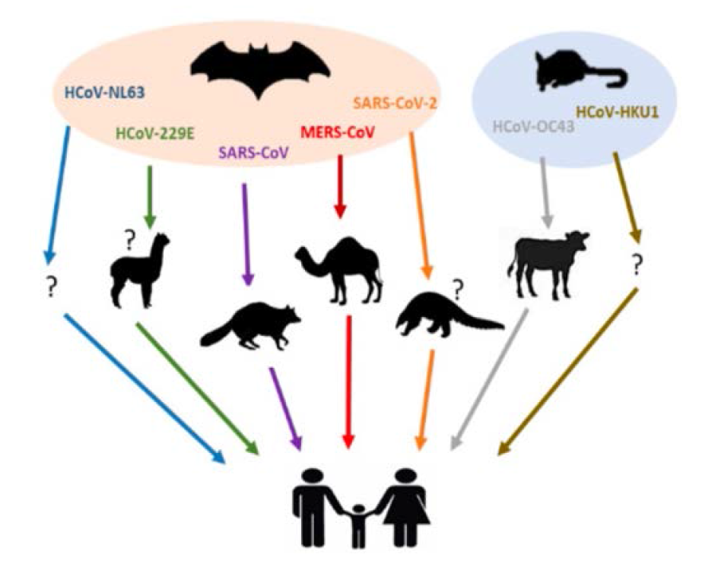
SARS-CoV-2 appears to have originated from bats, as it showed a 96.2% identity to the BatCoV RaTG13 genomic sequence. Pangolin-CoV showed high genomic sequence identity with RaTG13 (90.55%) and SARS-CoV-2 (91.02%), although there is greater identity (96.2%) among SARS-CoV -2 and RaTG13
Pangolin-CoV could have a similar pathogenic potential to SARS-CoV-2, given the high homology between the receptor binding domain (RBD) sequences, essential for infection and recognition of host cells via the ACE2 receptor . Notably, Pangolin-CoV and SARS-CoV-2 possess five identical key amino acid residues in RBD, while RaTG13 shares only one amino acid with SARS-CoV-2. It remains to be established whether Pangolin-CoV and RaTG13 are potential infectious agents for humans as well
Only SARS-CoV-2 contains a potential cut site for furin. Upon binding of the "Spike" protein (S) to ACE2, the enzyme furin (a host pleiotropic protease) cuts at the S1/S2 polybasic cleavage site (where S1 and S2 are the two subunits of the Spike protein), allowing of the virus in the host cell. The presence of a furin cleavage site determines the transmissibility and pathogenicity of SARS-CoV-like viruses and could explain why SARS-CoV-2 is so contagious. Instead, pangolin-CoV and all other SARS-CoVs lost the motif of the putative furin recognition sequence at the S1/S2 cleavage site. Interestingly, in addition to MERS-CoV, similar furin recognition sites have also been presented in some members of Alpha-, Beta- and Gamma-coronavirus. This raises the question of whether the furin motif in SARS-CoV-2 may have originated from existing S proteins or from recombination between Pangolin-CoV or RaTG13 and these other coronaviruses in an unknown intermediate host.
How SARS-CoV-2 originated and how it spread out?

Slide 7
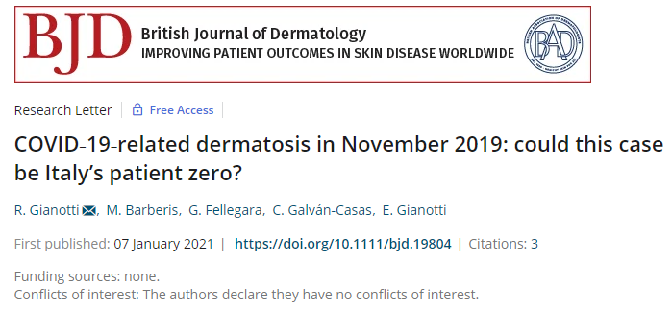
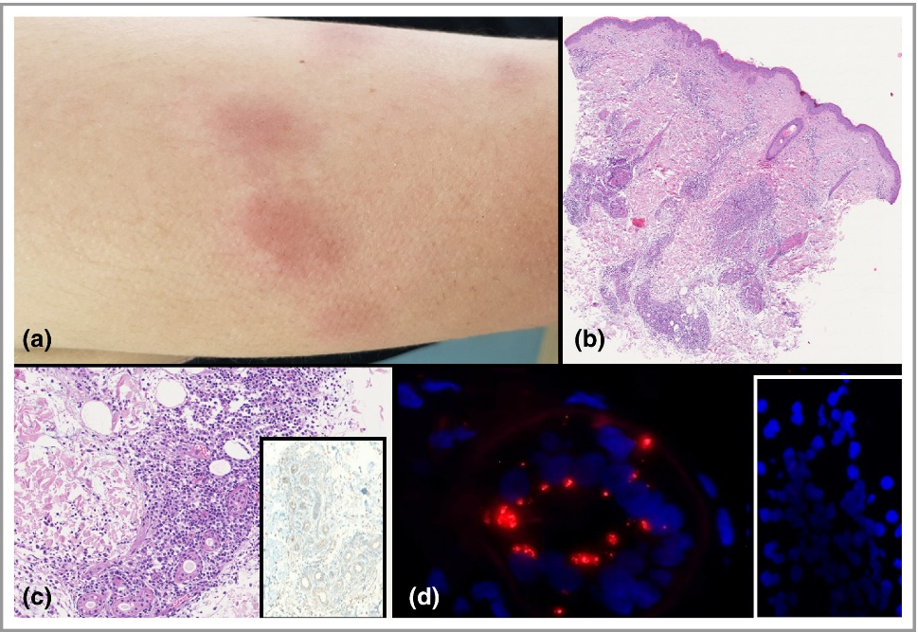
In November 2019, a 25‐year‐old woman presented with urticarial plaque‐like dermatosis on the arms. The only systemic symptom she complained about was a mild sore throat. A punch biopsy showed a dense perivascular and periglandular infiltration. We suspected ‘lupus erythematosus tumidus’. A PCR swab was not performed.
In July 2020, we realized that the histopathological features of the biopsy matched the minichilblain pattern described in our previously published paper on COVID‐19‐related dermatoses. Hence, we decided to study this biopsy again. We performed immunohistochemical investigations for SARS‐CoV‐2 nucleocapsid antigens on paraffin sections. We employed nine dermatoses biopsies and six cases of basal cell carcinoma (year 2018) as negative controls. In control cases, no immunohistochemical staining was observed. As positive control cases, we used skin biopsies from three patients who were positive for SARS‐CoV‐2 who presented skin lesions during hospitalization in the intensive care unit. In all positive control cases, immunohistochemistry stained the cuticular region of the eccrine glands. We also performed RNA fluorescence in situ hybridization (FISH) analysis using the HuluFISH technique (Pixel Biotech, Heidelberg, Germany) that enzymatically labels oligonucleotide probes (oligos), enabling SARS‐CoV‐2 mRNA detection at the single‐molecule level.

Slide 8
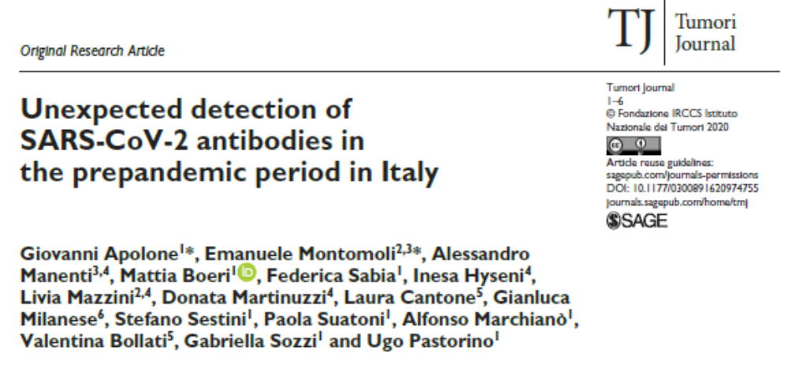
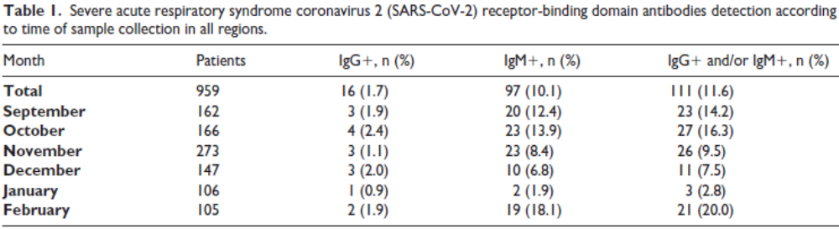
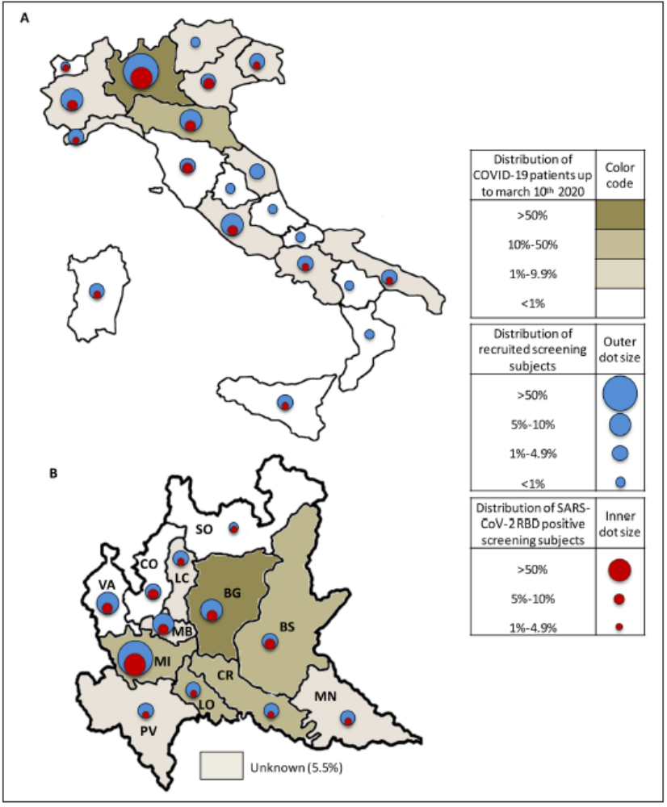
Abstract
There are no robust data on the real onset of severe acute respiratory syndrome coronavirus 2 (SARS-CoV-2) infection and spread in the prepandemic period worldwide. We investigated the presence of SARS-CoV-2 receptor-binding domain (RBD)–specific antibodies in blood samples of 959 asymptomatic individuals enrolled in a prospective lung cancer screening trial between September 2019 and March 2020 to track the date of onset, frequency, and temporal and geographic variations across the Italian regions. SARS-CoV-2 RBD-specific antibodies were detected in 111 of 959 (11.6%) individuals, starting from September 2019 (14%), with a cluster of positive cases (>30%) in the second week of February 2020 and the highest number (53.2%) in Lombardy. This study shows an unexpected very early circulation of SARS-CoV-2 among asymptomatic individuals in Italy several months before the first patient was identified, and clarifies the onset and spread of the coronavirus disease 2019 (COVID-19) pandemic. Finding SARS-CoV-2 antibodies in asymptomatic people before the COVID-19 outbreak in Italy may reshape the history of pandemic.

Slide 9
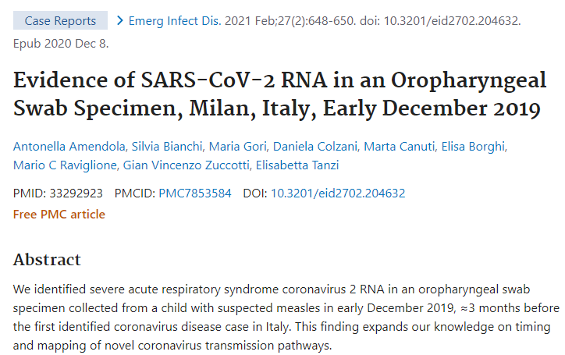
One oropharyngeal swab specimen tested positive. The amplicon was sequenced by using Sanger technology, resulting in a sequence of 409 bp. Sequence analysis performed by using BLAST showed 100%
identity to the reference sequence Wuhan-HU-1 as well as to sequences of other SARSCoV-2 strains circulating worldwide at a later stage; therefore, accurately determining the origin of the identified strain was
not possible.
The specimen was confirmed as positive by repeated amplification and sequencing, and all other specimens were repeatedly negative. The sequence was identified in a specimen collected from a 4-year-old boy who lived in the surrounding area of Milan and had no reported travel history.
On November 2, the child had cough and rhinitis; about a week later (November 30), he was taken to the emergency department with respiratory symptoms and vomiting. On December 1, he had onset of a measles-like rash; on December 5 (14 days after symptom onset), the oropharyngeal swab specimen was obtained for clinical diagnosis of suspected measles. This patient’s clinical course, which included late skin manifestations, resembles what has been reported by other authors;
maculopapular lesions have been among the most prevalent cutaneous manifestations observed during the COVID-19 pandemic, and several studies have noticed a later onset in younger patients.
As participants in Italy’s Measles and Rubella Network, a sensitive case-based surveillance system, we observed in Milan during late autumn 2019 cases of suspected measles in patients who eventually tested negative for measles. We therefore retrospectively explored a possible etiologic involvement of SARS-CoV-2 in these non–measles-linked rash cases.
We analyzed oropharyngeal swabs specimens collected during September 2019–February 2020 from 39 consenting patients (mean age 19.9 years [range 8 months–73 years]). All laboratory procedures were conducted in a university research laboratory, accredited according to World Health Organization standards, dedicated exclusively to the surveillance of measles and rubella, and therefore designated as free from SARS-CoV-2.

Slide 10
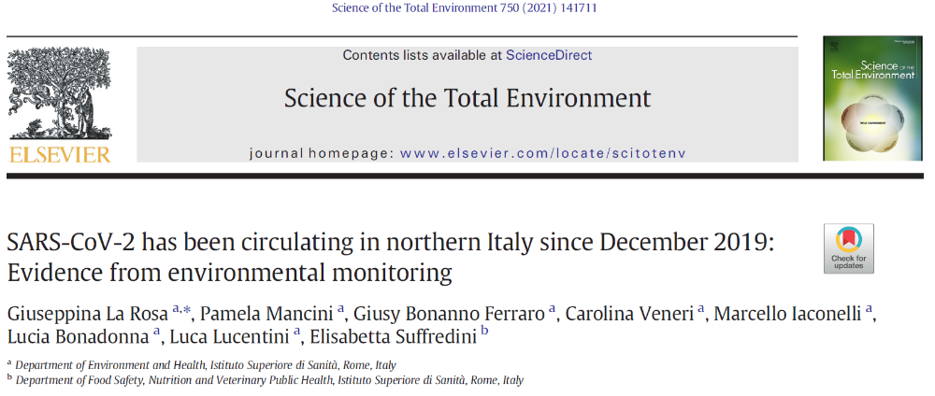
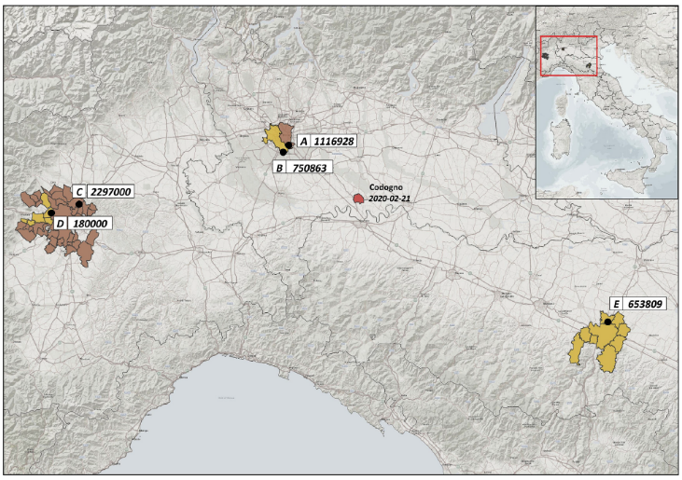
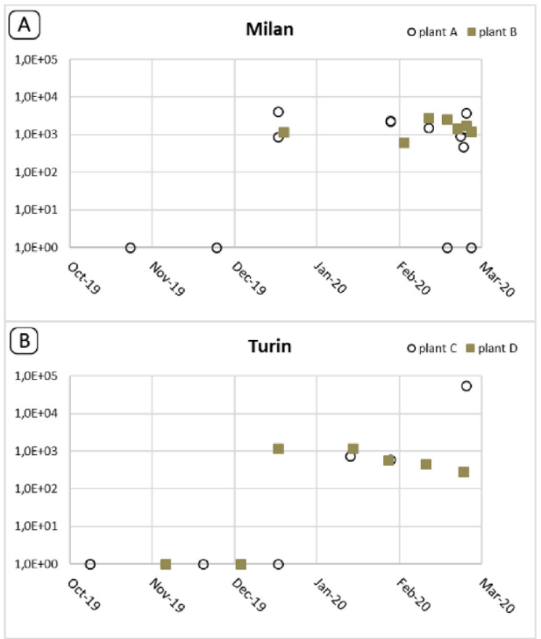
We investigated the possibility that SARS-CoV-2 emerged in Italy earlier than that date, by analysing 40 composite influent wastewater samples collected - in the framework of other wastewater-based epidemiology projects - between October 2019 and February 2020 from five wastewater treatment plants (WWTPs) in three cities and regions in northern Italy (Milan/Lombardy, Turin/Piedmont and Bologna/Emilia Romagna). Twenty-four additional samples collected in the same WWTPs between September 2018 and June 2019 (i.e. long before the onset of the epidemic) were included as ‘blank’ samples. Viral concentration was performed according to the standard World Health Organization
procedure for poliovirus sewage surveillance, with modifications. Molecular analysis was undertaken
with both nested RT-PCR and real-time RT-PCR assays. A total of 15 positive samples were confirmed by both methods. The earliest dates back to 18 December 2019 in Milan and Turin and 29 January 2020 in Bologna.
Virus concentration in the samples ranged from below the limit of detection (LOD) to 5.6×10⁴ genome copies(g.c.)/L, and most of the samples (23 out of 26) were below the limit of quantification of PCR.

Slide 11
SARS-CoV-2 and COVID-19
What we know
1
How SARS-CoV-2 originated and how it spread out?
2
Are there any alternative transmission routes?
3
Why does disease severity vary among individuals?

Slide 12
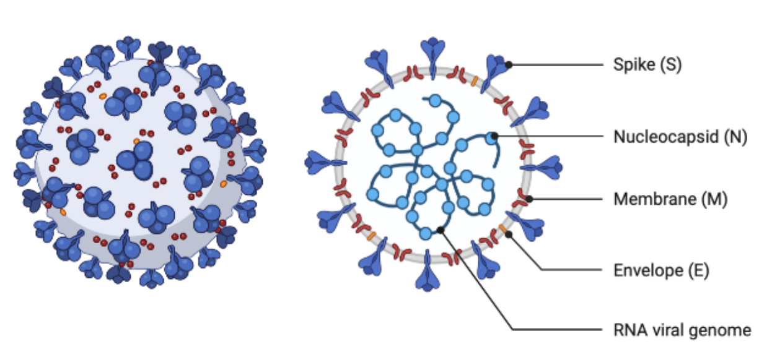
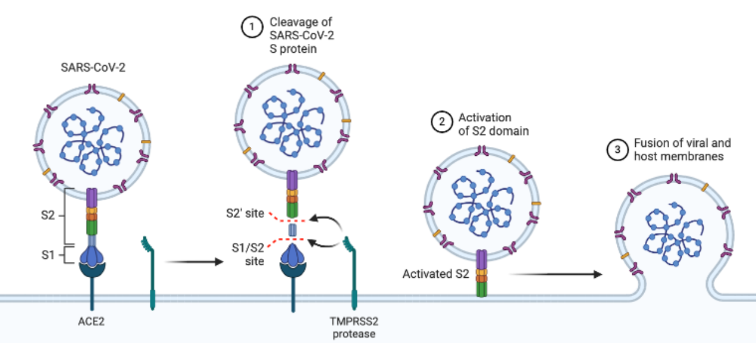
SARS-CoV-2 virus
ACE2 binding and infection mechanism

Slide 13
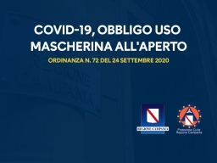

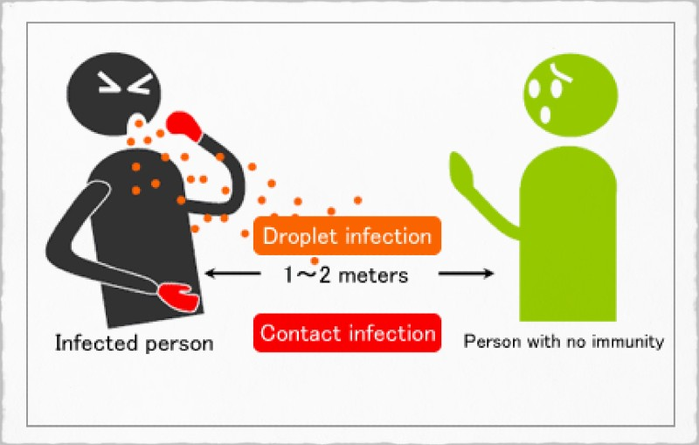
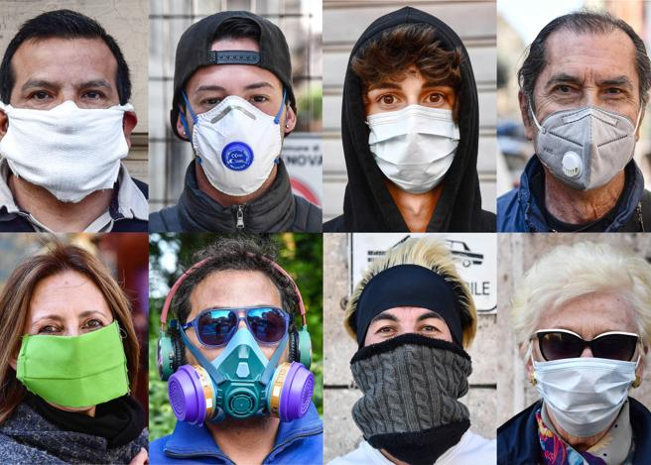
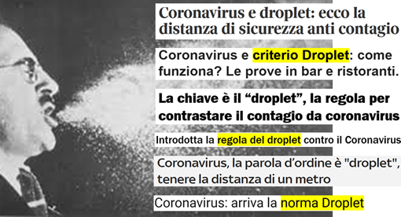

Slide 14
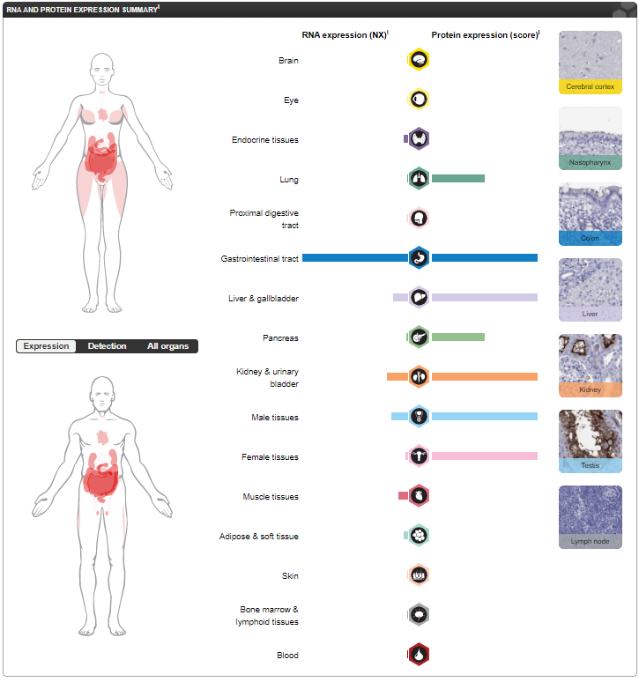

ACE2 mRNA and protein expression

Slide 15
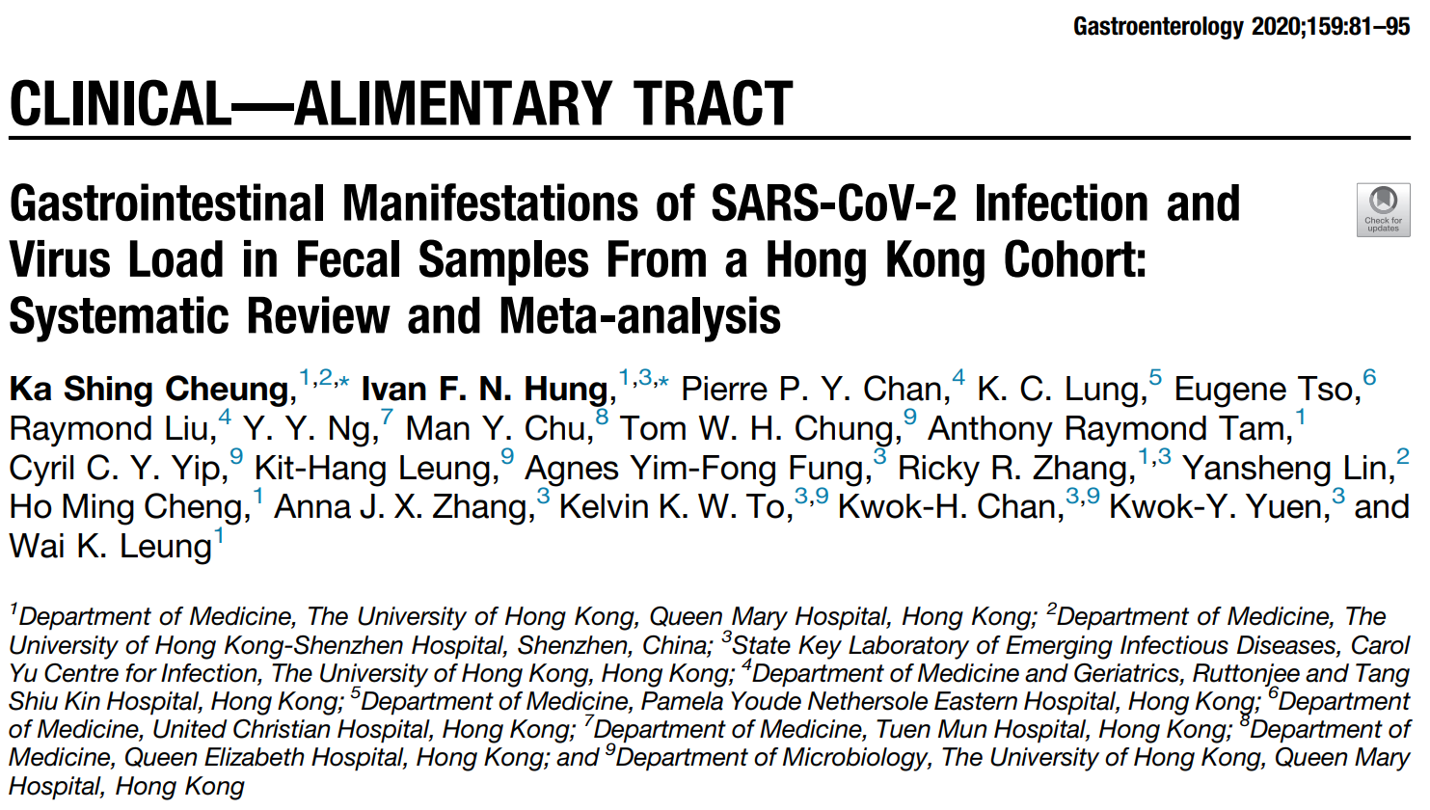
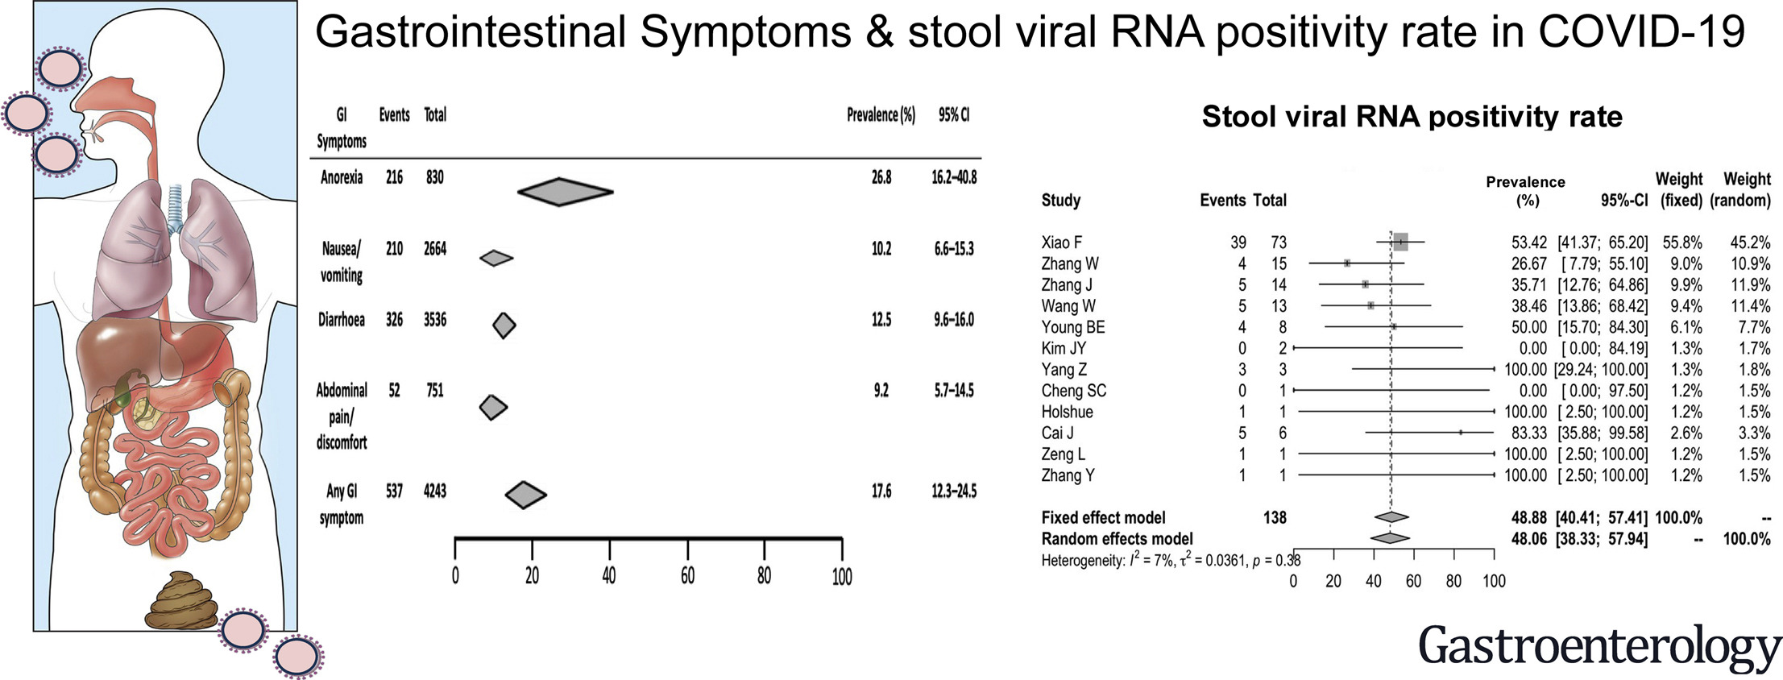
COVID-19 related GI symptoms

Slide 16
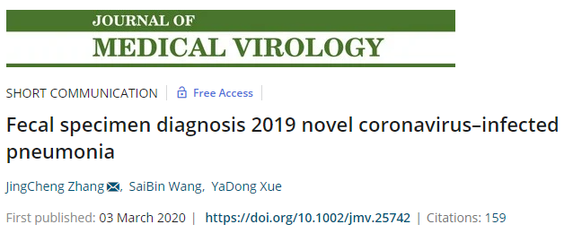
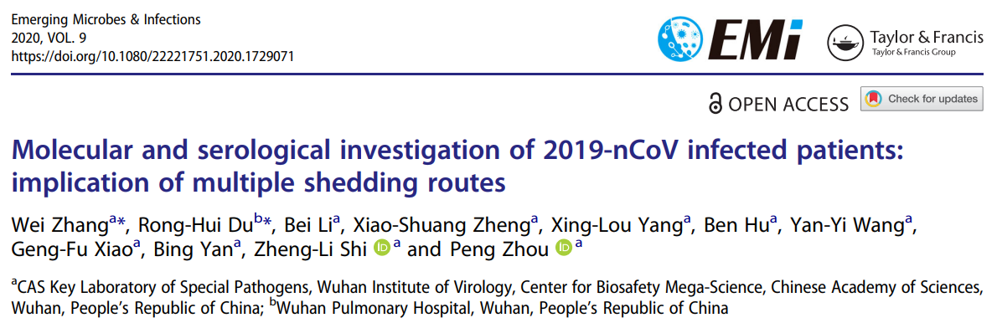
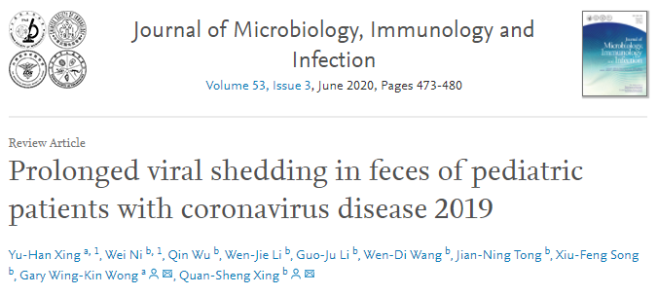
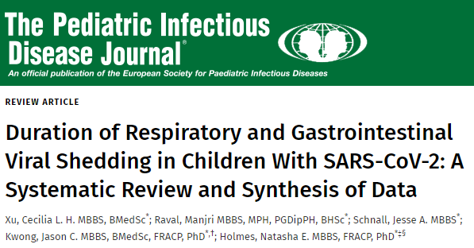
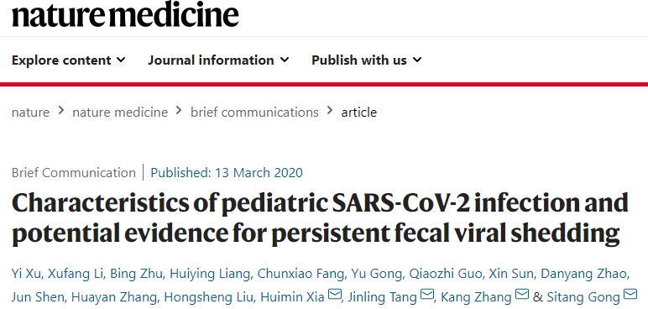

Slide 17
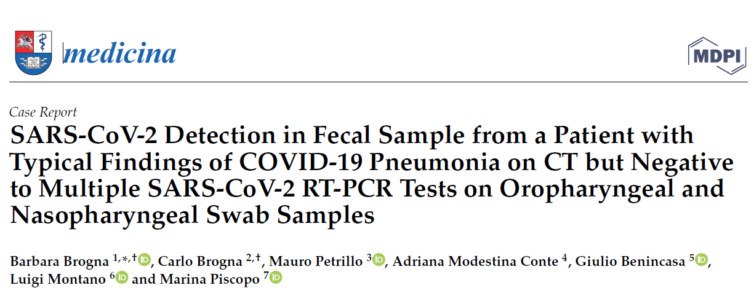
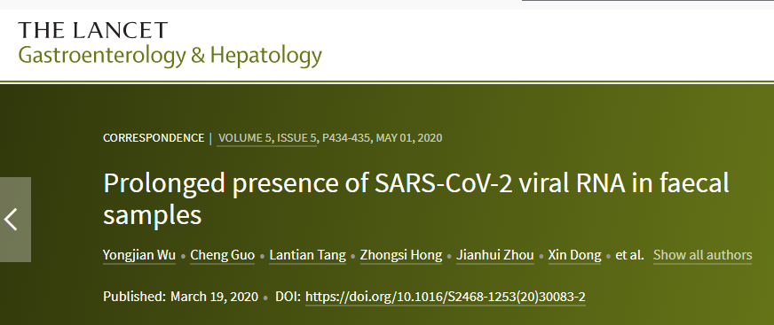
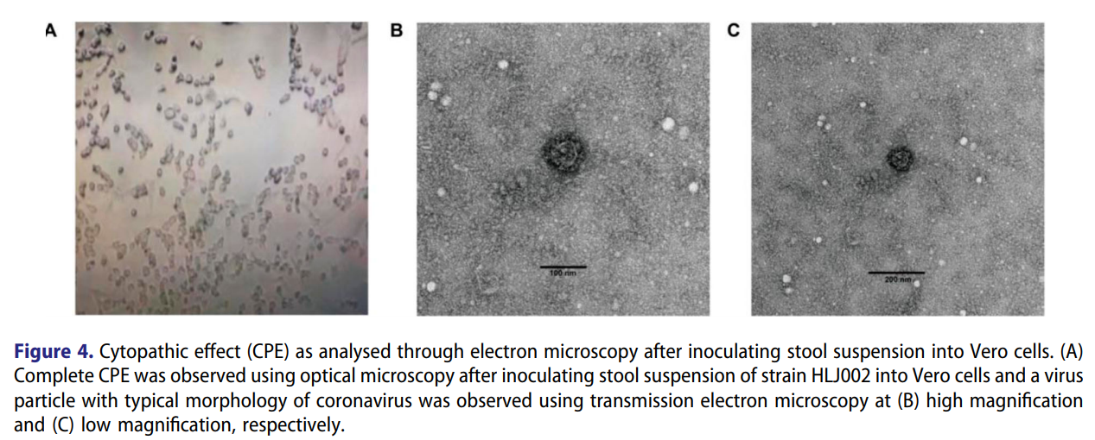
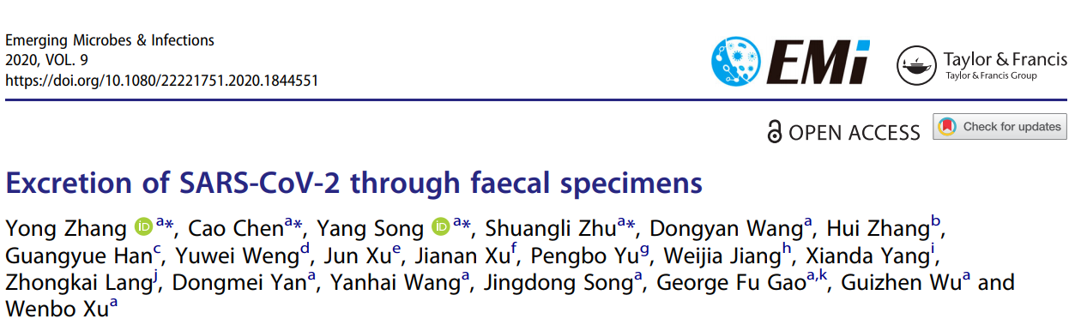

Slide 18
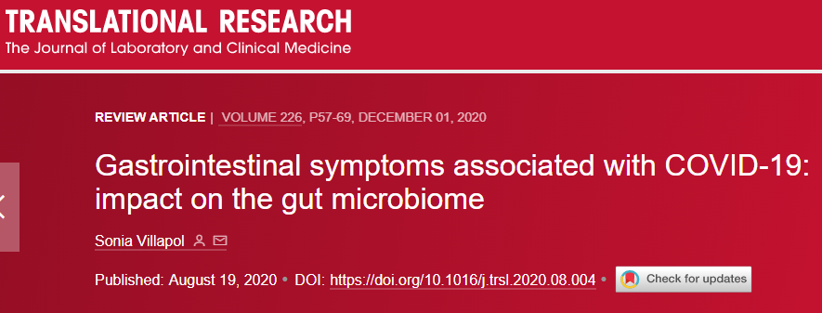
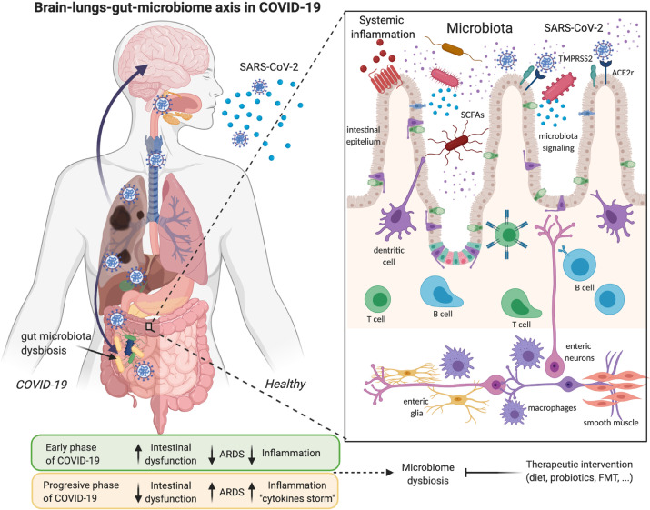
COVID-19 effects on GI
Infection and death of host GI cells
Virus replication
Gut permeability increase
Gut immune response activation
Dysbiosis
Spike protein superantigen activity
Cytokine storm
SARS-CoV-2 reservoir
Virus spread out
Role in the vaccine side effects

Slide 19
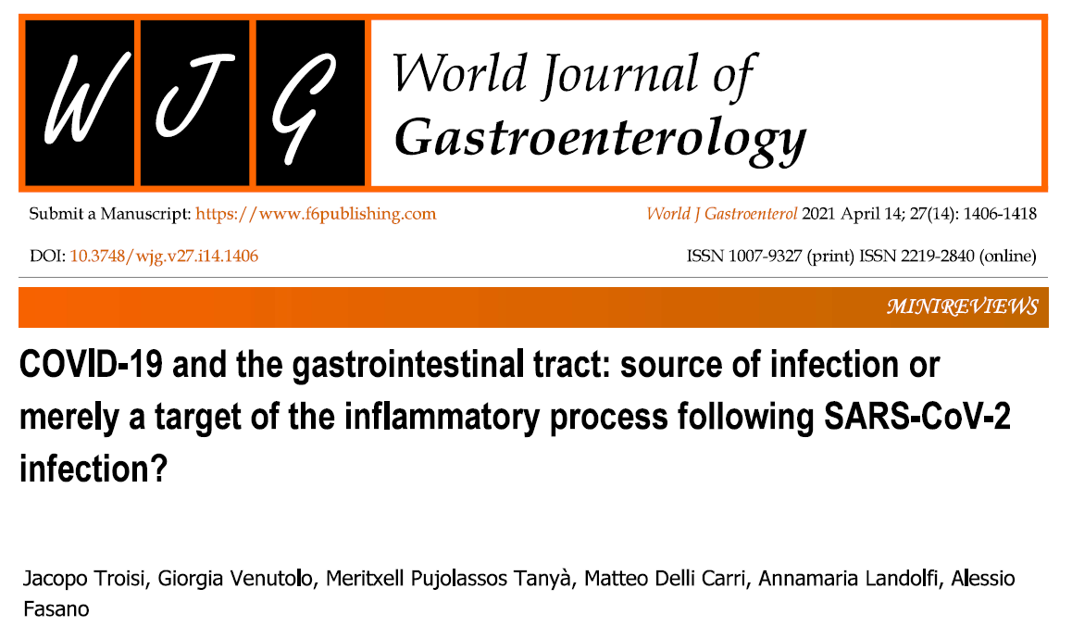
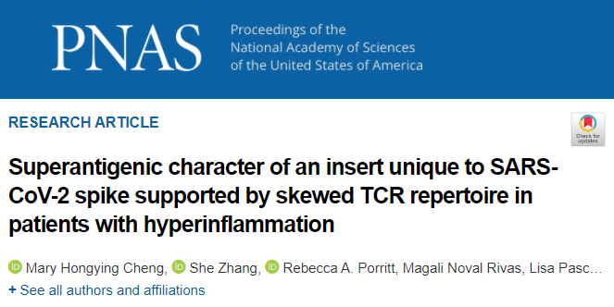
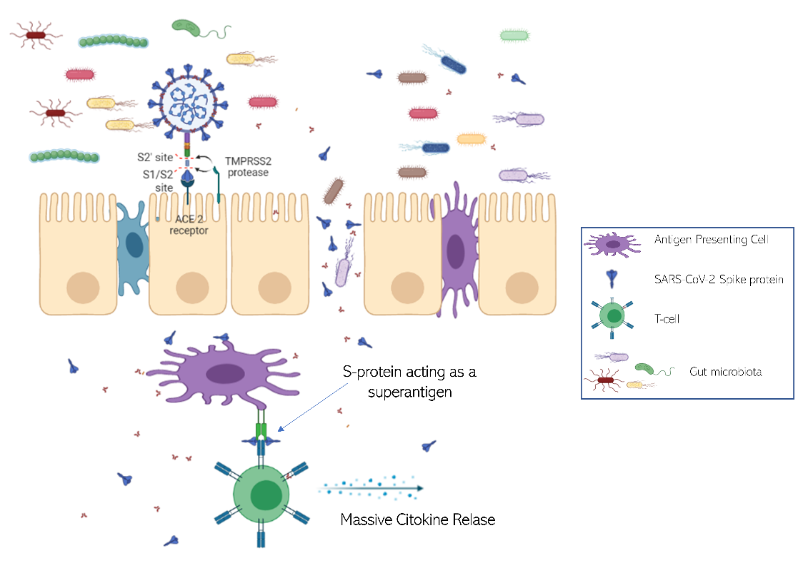
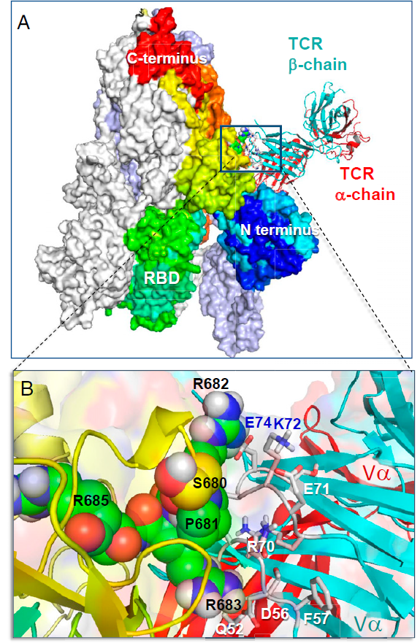

Slide 20
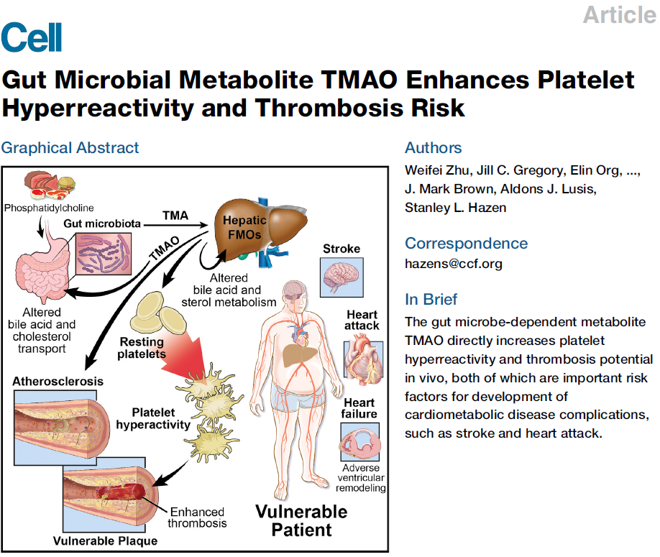
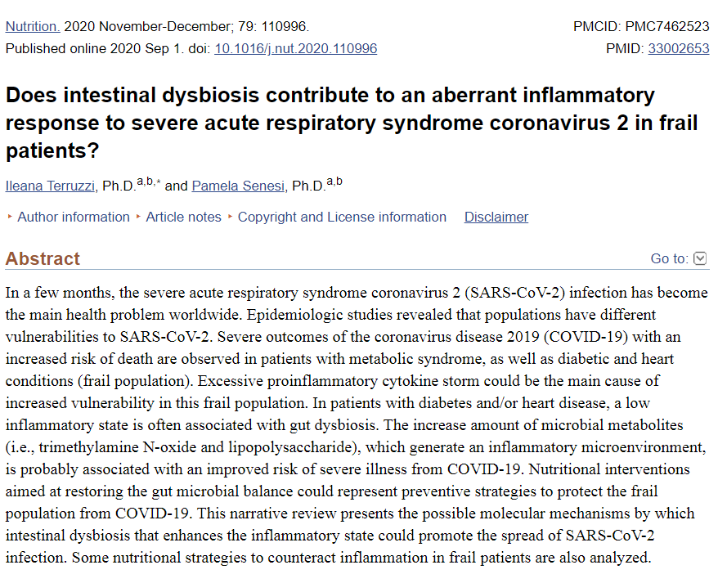

Slide 21
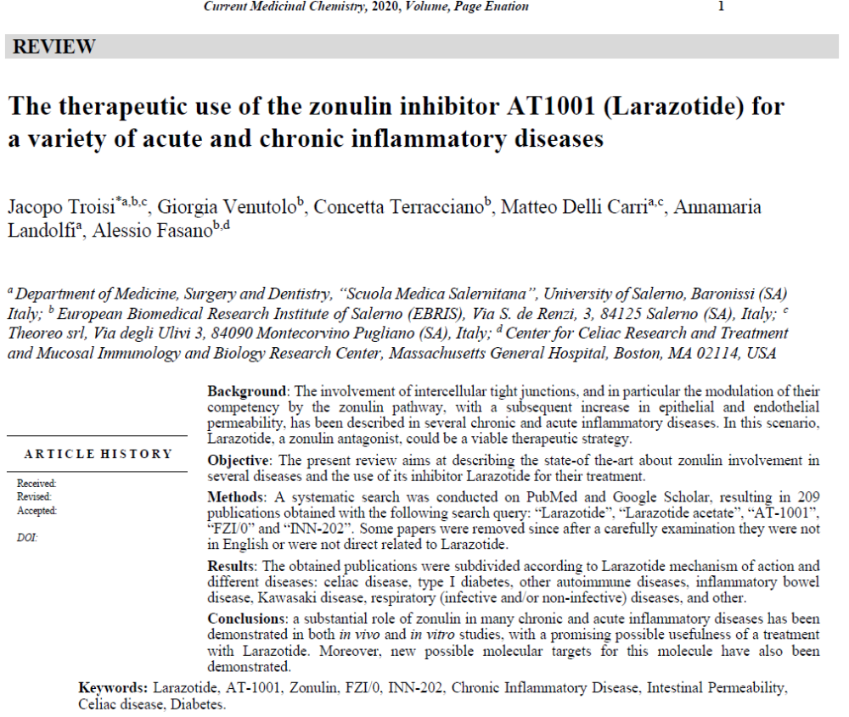
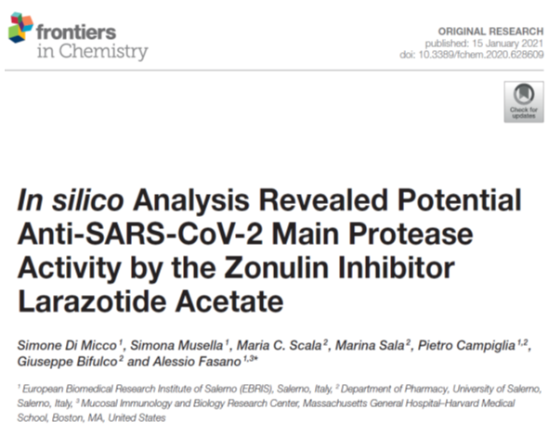

Slide 22
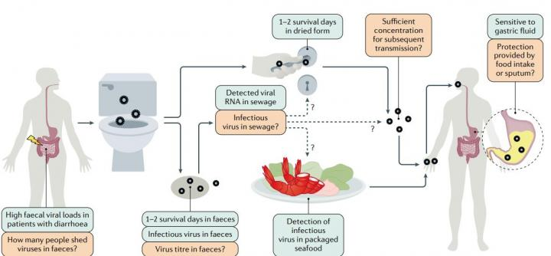

Slide 23
SARS-CoV-2 and COVID-19
What we know
1
How SARS-CoV-2 originated and how it spread out?
2
Are there any alternative transmission routes?
3
Why does disease severity vary among individuals?

Slide 24
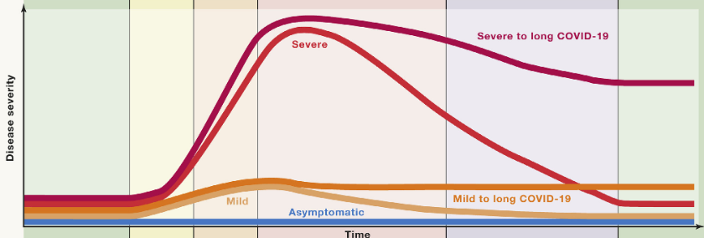
COVID-19 symptoms spectrum

Slide 25
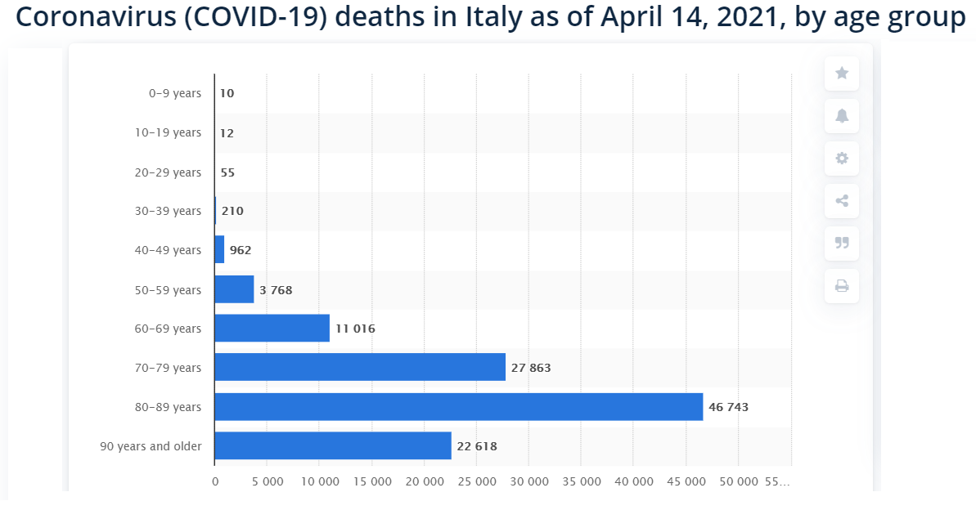
118.000 COVID-19 related death
1.250 COVID-19 related death under 50 years

Slide 26
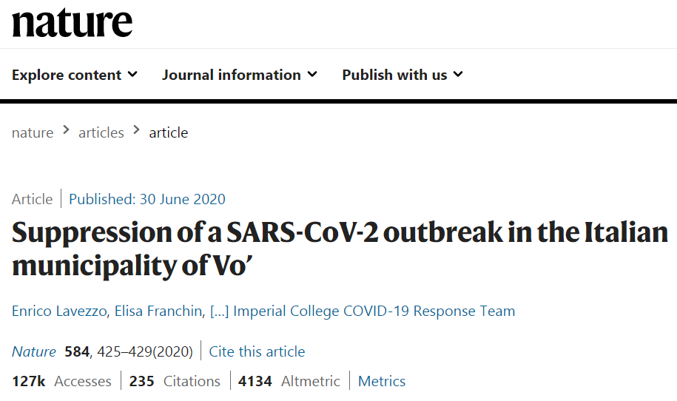
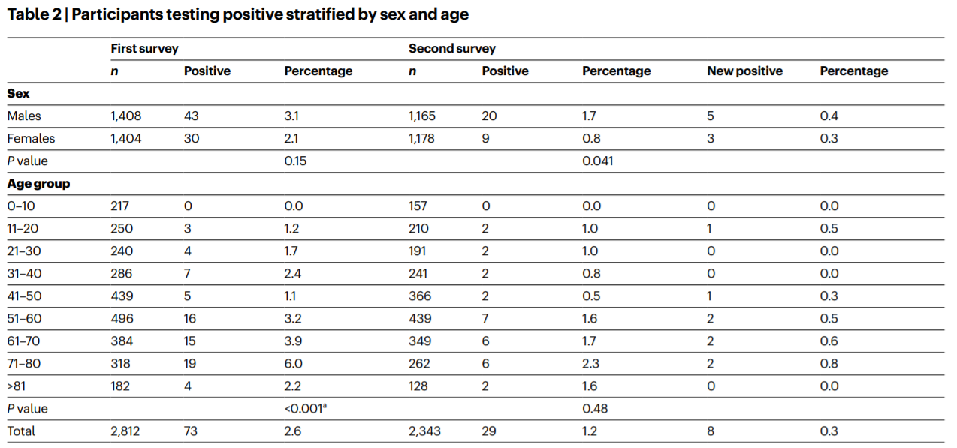
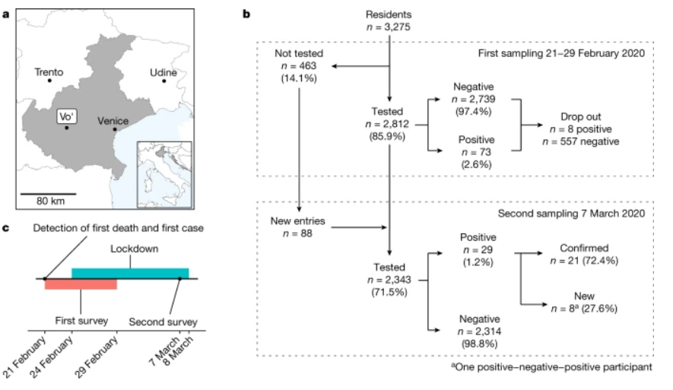

Slide 27
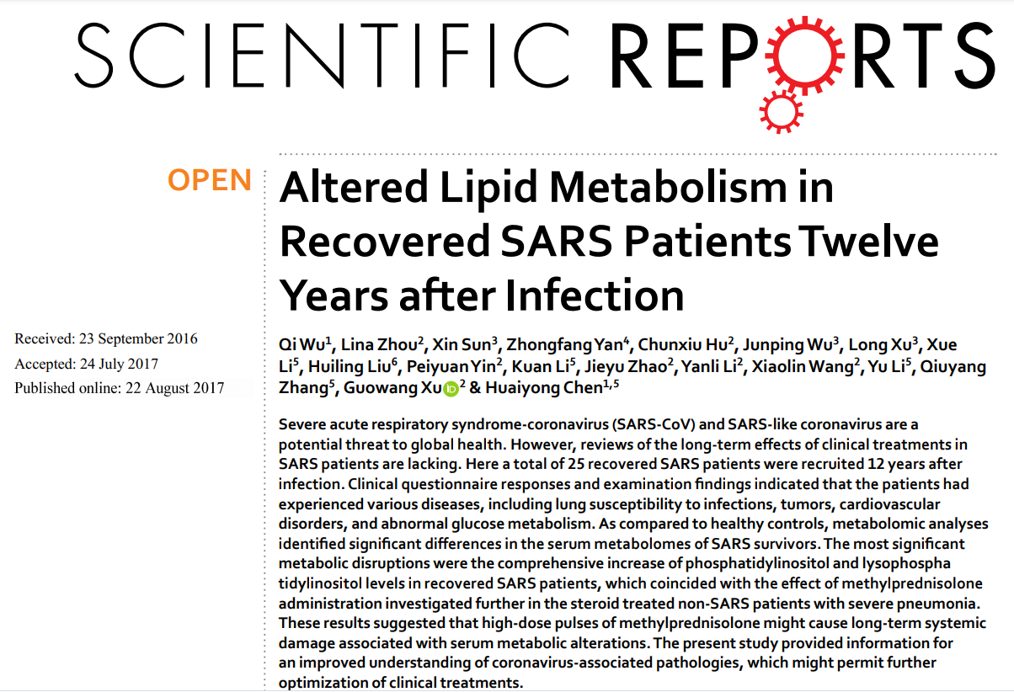

Slide 28
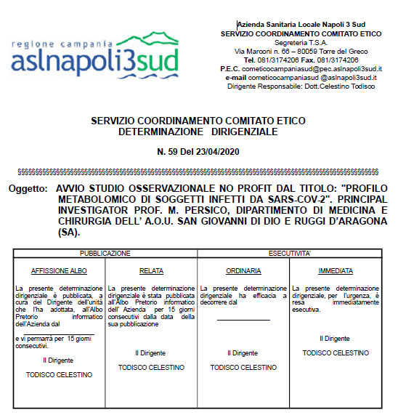

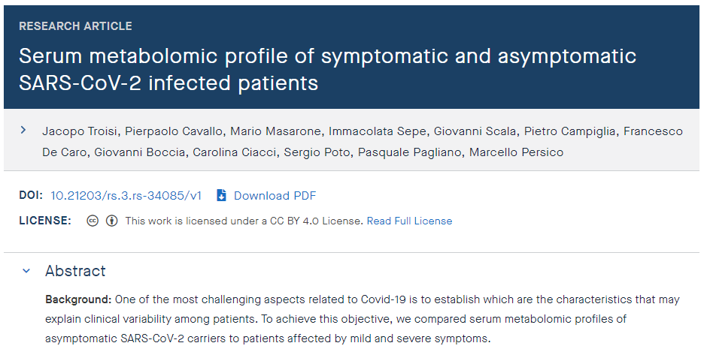
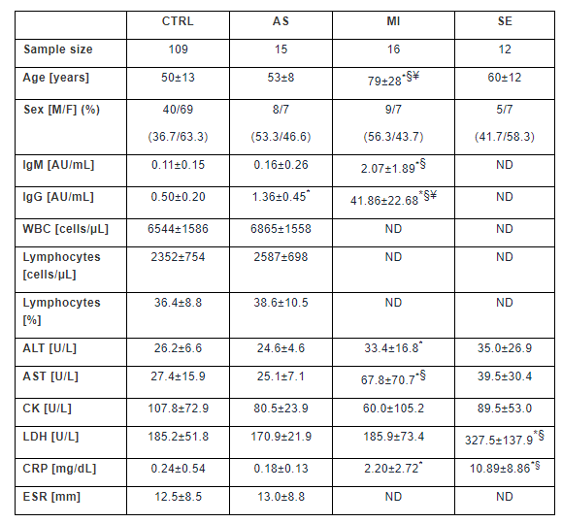
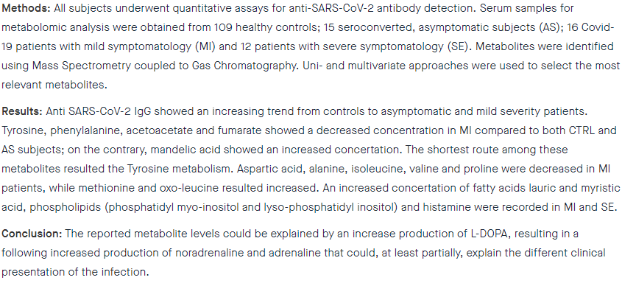
1145
125

Slide 29
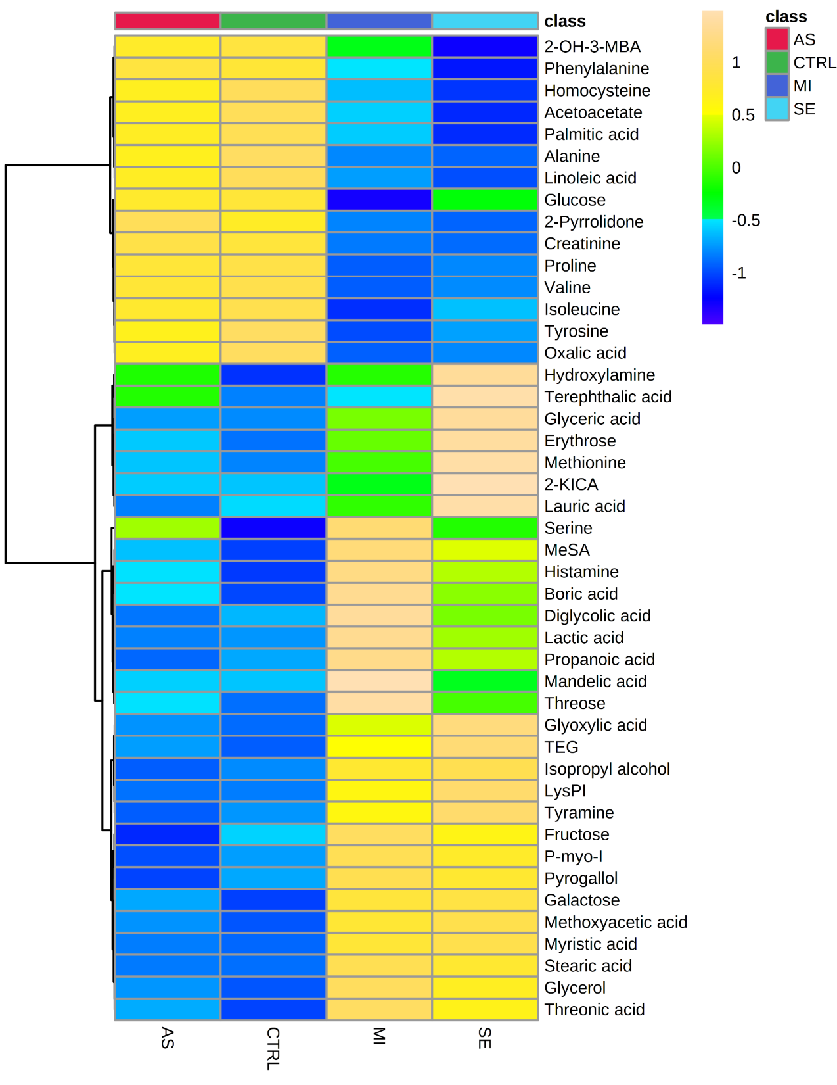
A
B
C
D

Slide 30


Slide 31


Slide 32
When a bacterial suspension is inoculated into guinea-pig skin and muscle, the resulting infection is much more severe if a small quantity of adrenaline is injected at the same time (Lancet, 1948);
Since 1971 several cases of adrenaline-induced pulmonary edema have been reported (Ersoz,1971; Syal, 2011);
Circulating adrenaline induces a dose-dependent increase in plasma IL-6 concentrations. Anti IL-6 treatment was proven effective in COVID-19 affected patients.
Adrenaline also improves renin production by the kidney by stimulating adenylate cyclase-5.
Moreover, according to studies conducted in mice, the interaction of the SARS-CoV-2 spike protein with ACE2 induces a decrease in the levels of ACE2 on the cell surface, since it induces the internalization and degradation of the protein, contributing to lung damage. Thus, adrenaline synthesis increase could be read as a compensatory response to the ACE2 decreased levels.
Adrenaline and COVID-19

Slide 33






Slide 34


The specific metabolome profiling of patients infected by SARS‑COV‑2 supports the key role of tryptophan‑nicotinamide pathway and cytosine metabolism
H. Blasco*, C. Bessy, L. Plantier, A. Lefevre, E. Piver, L. Bernard, J. Marlet, K. Stefic, Isabelle Benz‑de Bretagne, P. Cannet, H. Lumbu, T.Morel, P. Boulard, C. R. Andres, P. Vourc’h, O. Hérault, A.Guillon & P. Emond.
October , 2020
Metaboliti caratteristici di PAZIENTI COVID-19 con DECORSO SEVERO | Metabolismo delle pirimidine proveniente dalla lisi delle cellule infettate da SARS-CoV-2
 | Segnale infiammatorio associato al metabolismo triptofano-kynurenina
Notes:
They suggested that NAD synthetized from tryptophan modulates
macrophage activity such as the release of interleukin-6 and tumor necrosis factor alpha

Slide 35


Cytokine release syndrome (CRS) is a major cause of the multi-organ injury and fatal out- come induced by SARS-CoV-2 infection in severe COVID-19 patients.
Metabolism can modulate the immune responses against infectious diseases, yet our understanding remains limited on how host metabolism correlates with inflammatory responses and affects cytokine release in COVID-19 patients.
Here we perform both metabolomics and cytokine/chemokine profiling on serum samples from healthy controls, mild and severe COVID-19 patients, and delineate their global metabolic and immune response landscape.

Slide 36
Correlation analyses show tight associations between metabolites and proinflammatory cytokines/chemokines, such as IL-6, M-CSF, IL-1α, IL-1β, and imply a potential regulatory crosstalk between arginine, tryptophan, purine metabolism and hyperinflammation.
Importantly, we also demonstrate that targeting metabolism markedly modulates the proinflammatory cytokines release by peripheral blood mononuclear cells isolated from SARS-CoV-2-infected rhesus macaques ex vivo, hinting that exploiting metabolic alterations may be a potential strategy for treating fatal CRS in COVID-19.

Slide 37




Metabolomics profiles of a pediatrics cohort of SARS-CoV-2 infected subjects

Slide 39

Metabolite | Selection criteria | HMDB code
3-Pyridinol | VIP | NA
Acetamide | VIP | HMDB0031645
Androstenedione | VIP | HMDB0000053
Arabinose 4 | VIP | HMDB0000646
Benzyl alcohol | VIP | HMDB0003119
Glycolic acid | VIP | HMDB0000115
Myristic acid | VIP | HMDB0000806
Oleic acid | VIP | HMDB0000207
Palmitic Acid | VIP | HMDB0000220
Stearic acid | VIP | HMDB0000827
Threose 1 | VIP | HMDB0002649
 | Total | Expected | Hits | Raw p | Holm p | FDR
Fatty Acid Biosynthesis | 35 | 0,342 | 2 | 0,043 | 1 | 1
Androstenedione Metabolism | 24 | 0,234 | 1 | 0,212 | 1 | 1
Glycerolipid Metabolism | 25 | 0,244 | 1 | 0,22 | 1 | 1
Plasmalogen Synthesis | 26 | 0,254 | 1 | 0,228 | 1 | 1
Mitochondrial Beta-Oxidation of Long Chain Saturated Fatty Acids | 28 | 0,273 | 1 | 0,243 | 1 | 1
Androgen and Estrogen Metabolism | 33 | 0,322 | 1 | 0,28 | 1 | 1
Fatty Acid Elongation In Mitochondria | 35 | 0,342 | 1 | 0,295 | 1 | 1
Fatty acid Metabolism | 43 | 0,42 | 1 | 0,35 | 1 | 1
Steroid Biosynthesis | 48 | 0,469 | 1 | 0,383 | 1 | 1
Bile Acid Biosynthesis | 65 | 0,635 | 1 | 0,483 | 1 | 1

Slide 40




3 Classes: COVID-T1_2 vs COVID-T3_4 vs CTRL

Slide 41

3 Classes: COVID-T1_2 vs COVID-T2_4 vs CTRL
 | F value | p value | -log10(p) | FDR | Fisher's LSD
Arabinose 4 | 10,611 | 4,40E-05 | 4,3563 | 0,010919 | COVID-T1_2 - COVID-T2_4; COVID-T1_2 - CTRL; CTRL - COVID-T2_4
Myristic acid | 8,0032 | 0,000468 | 3,3298 | 0,038684 | COVID-T1_2 - COVID-T2_4; CTRL - COVID-T1_2; CTRL - COVID-T2_4

Slide 43

3 Classes: COVID-T1_2 vs COVID-T2_4 vs CTRL
Metabolite | Selection criteria | HMDB code
3-Hydroxybutyric acid | VIP | HMDB0000011
3-Pyridinol | VIP | NA
5-Methyluridine | VIP | HMDB0000884
Acetamide | VIP | HMDB0031645
Acetic acid | VIP | HMDB0000042
Acetoacetic acid | VIP | HMDB0000060
Androstenedione | VIP | HMDB0000053
Arabinose 4 | VIP and ANOVA | HMDB0000646
Benzyl alcohol | VIP | HMDB0003119
Glycolic acid | VIP | HMDB0000115
Myristic acid | VIP and ANOVA | HMDB0000806
Palmitic Acid | VIP | HMDB0000220
Pyrimidine | VIP | HMDB0003361
Threose 1 | VIP | HMDB0002649
 | Total | Expected | Hits | Raw p | Holm p | FDR
Fatty Acid Biosynthesis | 35 | 0,444 | 4 | 0,000659 | 0,0646 | 0,0646
Ketone Body Metabolism | 13 | 0,165 | 2 | 0,0107 | 1 | 0,526
Butyrate Metabolism | 19 | 0,241 | 1 | 0,217 | 1 | 1
Ethanol Degradation | 19 | 0,241 | 1 | 0,217 | 1 | 1
Androstenedione Metabolism | 24 | 0,305 | 1 | 0,267 | 1 | 1
Glycerolipid Metabolism | 25 | 0,317 | 1 | 0,276 | 1 | 1
Phenylalanine and Tyrosine Metabolism | 28 | 0,355 | 1 | 0,304 | 1 | 1
Amino Sugar Metabolism | 33 | 0,419 | 1 | 0,348 | 1 | 1
Androgen and Estrogen Metabolism | 33 | 0,419 | 1 | 0,348 | 1 | 1
Fatty Acid Elongation In Mitochondria | 35 | 0,444 | 1 | 0,365 | 1 | 1
Aspartate Metabolism | 35 | 0,444 | 1 | 0,365 | 1 | 1
Fatty acid Metabolism | 43 | 0,546 | 1 | 0,429 | 1 | 1
Steroid Biosynthesis | 48 | 0,609 | 1 | 0,466 | 1 | 1
Pyruvate Metabolism | 48 | 0,609 | 1 | 0,466 | 1 | 1
Valine, Leucine and Isoleucine Degradation | 60 | 0,762 | 1 | 0,546 | 1 | 1
Bile Acid Biosynthesis | 65 | 0,825 | 1 | 0,576 | 1 | 1
Tyrosine Metabolism | 72 | 0,914 | 1 | 0,615 | 1 | 1

Slide 44


Slide 45

ATTAAAGGTTTATACCTTCCCAGGTAACAAACCAACCAACTTTCGATCTCTTGTAGATCTGTTCTCTAAA
CGAACTTTAAAATCTGTGTGGCTGTCACTCGGCTGCATGCTTAGTGCACTCACGCAGTATAATTAATAAC
TAATTACTGTCGTTGACAGGACACGAGTAACTCGTCTATCTTCTGCAGGCTGCTTACGGTTTCGTCCGTG
TTGCAGCCGATCATCAGCACATCTAGGTTTCGTCCGGGTGTGACCGAAAGGTAAGATGGAGAGCCTTGTC
CCTGGTTTCAACGAGAAAACACACGTCCAACTCAGTTTGCCTGTTTTACAGGTTCGCGACGTGCTCGTAC
GTGGCTTTGGAGACTCCGTGGAGGAGGTCTTATCAGAGGCACGTCAACATCTTAAAGATGGCACTTGTGG
CTTAGTAGAAGTTGAAAAAGGCGTTTTGCCTCAACTTGAACAGCCCTATGTGTTCATCAAACGTTCGGAT
GCTCGAACTGCACCTCATGGTCATGTTATGGTTGAGCTGGTAGCAGAACTCGAAGGCATTCAGTACGGTC
GTAGTGGTGAGACACTTGGTGTCCTTGTCCCTCATGTGGGCGAAATACCAGTGGCTTACCGCAAGGTTCT
TCTTCGTAAGAACGGTAATAAAGGAGCTGGTGGCCATAGTTACGGCGCCGATCTAAAGTCATTTGACTTA
GGCGACGAGCTTGGCACTGATCCTTATGAAGATTTTCAAGAAAACTGGAACACTAAACATAGCAGTGGTG
TTACCCGTGAACTCATGCGTGAGCTTAACGGAGGGGCATACACTCGCTATGTCGATAACAACTTCTGTGG
CCCTGATGGCTACCCTCTTGAGTGCATTAAAGACCTTCTAGCACGTGCTGGTAAAGCTTCATGCACTTTG
TCCGAACAACTGGACTTTATTGACACTAAGAGGGGTGTATACTGCTGCCGTGAACATGAGCATGAAATTG
CTTGGTACACGGAACGTTCTGAAAAGAGCTATGAATTGCAGACACCTTTTGAAATTAAATTGGCAAAGAA
ATTTGACACCTTCAATGGGGAATGTCCAAATTTTGTATTTCCCTTAAATTCCATAATCAAGACTATTCAA
CCAAGGGTTGAAAAGAAAAAGCTTGATGGCTTTATGGGTAGAATTCGATCTGTCTATCCAGTTGCGTCAC
CAAATGAATGCAACCAAATGTGCCTTTCAACTCTCATGAAGTGTGATCATTGTGGTGAAACTTCATGGCA
GACGGGCGATTTTGTTAAAGCCACTTGCGAATTTTGTGGCACTGAGAATTTGACTAAAGAAGGTGCCACT
ACTTGTGGTTACTTACCCCAAAATGCTGTTGTTAAAATTTATTGTCCAGCATGTCACAATTCAGAAGTAG
GACCTGAGCATAGTCTTGCCGAATACCATAATGAATCTGGCTTGAAAACCATTCTTCGTAAGGGTGGTCG
CACTATTGCCTTTGGAGGCTGTGTGTTCTCTTATGTTGGTTGCCATAACAAGTGTGCCTATTGGGTTCCA
CGTGCTAGCGCTAACATAGGTTGTAACCATACAGGTGTTGTTGGAGAAGGTTCCGAAGGTCTTAATGACA
ACCTTCTTGAAATACTCCAAAAAGAGAAAGTCAACATCAATATTGTTGGTGACTTTAAACTTAATGAAGA
GATCGCCATTATTTTGGCATCTTTTTCTGCTTCCACAAGTGCTTTTGTGGAAACTGTGAAAGGTTTGGAT
TATAAAGCATTCAAACAAATTGTTGAATCCTGTGGTAATTTTAAAGTTACAAAAGGAAAAGCTAAAAAAG
GTGCCTGGAATATTGGTGAACAGAAATCAATACTGAGTCCTCTTTATGCATTTGCATCAGAGGCTGCTCG
TGTTGTACGATCAATTTTCTCCCGCACTCTTGAAACTGCTCAAAATTCTGTGCGTGTTTTACAGAAGGCC
GCTATAACAATACTAGATGGAATTTCACAGTATTCACTGAGACTCATTGATGCTATGATGTTCACATCTG
ATTTGGCTACTAACAATCTAGTTGTAATGGCCTACATTACAGGTGGTGTTGTTCAGTTGACTTCGCAGTG
GCTAACTAACATCTTTGGCACTGTTTATGAAAAACTCAAACCCGTCCTTGATTGGCTTGAAGAGAAGTTT
AAGGAAGGTGTAGAGTTTCTTAGAGACGGTTGGGAAATTGTTAAATTTATCTCAACCTGTGCTTGTGAAA
TTGTCGGTGGACAAATTGTCACCTGTGCAAAGGAAATTAAGGAGAGTGTTCAGACATTCTTTAAGCTTGT
AAATAAATTTTTGGCTTTGTGTGCTGACTCTATCATTATTGGTGGAGCTAAACTTAAAGCCTTGAATTTA
GGTGAAACATTTGTCACGCACTCAAAGGGATTGTACAGAAAGTGTGTTAAATCCAGAGAAGAAACTGGCC
TACTCATGCCTCTAAAAGCCCCAAAAGAAATTATCTTCTTAGAGGGAGAAACACTTCCCACAGAAGTGTT
AACAGAGGAAGTTGTCTTGAAAACTGGTGATTTACAACCATTAGAACAACCTACTAGTGAAGCTGTTGAA
GCTCCATTGGTTGGTACACCAGTTTGTATTAACGGGCTTATGTTGCTCGAAATCAAAGACACAGAAAAGT
ACTGTGCCCTTGCACCTAATATGATGGTAACAAACAATACCTTCACACTCAAAGGCGGTGCACCAACAAA
GGTTACTTTTGGTGATGACACTGTGATAGAAGTGCAAGGTTACAAGAGTGTGAATATCACTTTTGAACTT
GATGAAAGGATTGATAAAGTACTTAATGAGAAGTGCTCTGCCTATACAGTTGAACTCGGTACAGAAGTAA
ATGAGTTCGCCTGTGTTGTGGCAGATGCTGTCATAAAAACTTTGCAACCAGTATCTGAATTACTTACACC
ACTGGGCATTGATTTAGATGAGTGGAGTATGGCTACATACTACTTATTTGATGAGTCTGGTGAGTTTAAA
TTGGCTTCACATATGTATTGTTCTTTCTACCCTCCAGATGAGGATGAAGAAGAAGGTGATTGTGAAGAAG
AAGAGTTTGAGCCATCAACTCAATATGAGTATGGTACTGAAGATGATTACCAAGGTAAACCTTTGGAATT
TGGTGCCACTTCTGCTGCTCTTCAACCTGAAGAAGAGCAAGAAGAAGATTGGTTAGATGATGATAGTCAA
CAAACTGTTGGTCAACAAGACGGCAGTGAGGACAATCAGACAACTACTATTCAAACAATTGTTGAGGTTC
AACCTCAATTAGAGATGGAACTTACACCAGTTGTTCAGACTATTGAAGTGAATAGTTTTAGTGGTTATTT
AAAACTTACTGACAATGTATACATTAAAAATGCAGACATTGTGGAAGAAGCTAAAAAGGTAAAACCAACA
GTGGTTGTTAATGCAGCCAATGTTTACCTTAAACATGGAGGAGGTGTTGCAGGAGCCTTAAATAAGGCTA
CTAACAATGCCATGCAAGTTGAATCTGATGATTACATAGCTACTAATGGACCACTTAAAGTGGGTGGTAG
TTGTGTTTTAAGCGGACACAATCTTGCTAAACACTGTCTTCATGTTGTCGGCCCAAATGTTAACAAAGGT
Thanks

